Slide 1




Group - 3
SOC DESIGN OF OVEN
190205036
190205058
190205063
190205065
190205121

Slide 2




OVERVIEW
State Diagram
TestBench
SOC Design
Findings
Contribution

Slide 3

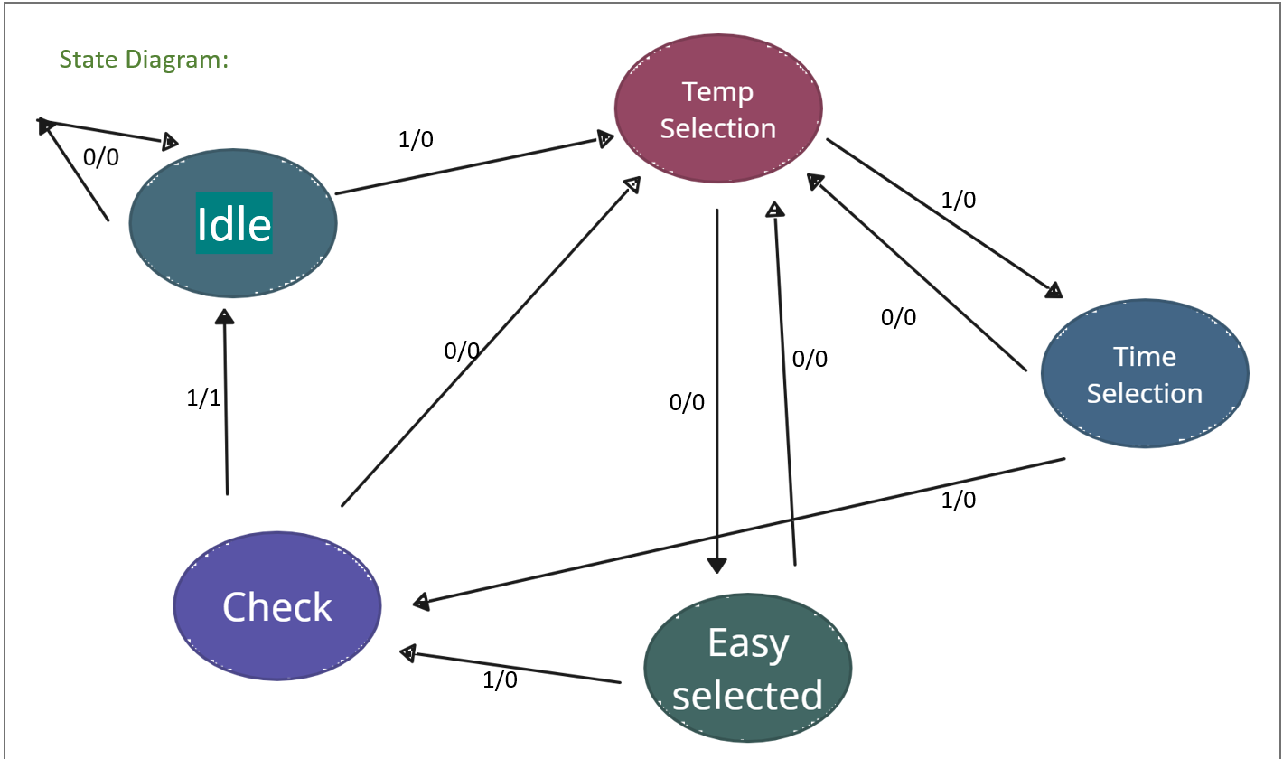
STATE DIAGRAM

Slide 4


MODULE OVEN(CLK , IN, TEMP , TEMP_TIME,OUT, TT);
input clk , in ;
input [1:0] tt;
output reg [1:0] temp ;
output reg [1:0] temp_time;
output reg out;
localparam idle = 3'b000 , temp_sel =3'b001 , easy_sel = 3'b010, time_sel= 3'b011, check = 3'b100 ;
reg [2:0] state ;
always @(posedge clk )
begin
case(state)
//idle
idle: begin
out<=in?0:0;
state<=in?temp_sel:idle;
end
//temp_sel
temp_sel : begin
out<=in?0:0;
state<=in?time_sel:easy_sel;
end
//easy_sel
easy_sel : begin
out<=in?0:0;
state<=in?check:temp_sel;
end
//time_sel
time_sel : begin
out<=in?0:0;
state<=in?check:temp_sel;
end
//check
check: begin
out<=in?1:0;
state<=in?idle:temp_sel;
end
// default
default: begin
out<=0;
state<=idle;
end
endcase
end
RTL
ALWAYS @(POSEDGE TT,STATE) BEGIN
//ideal
if ( state==3'b000) begin
temp<=0;
temp_time<=0;
end
//check
else if (state==3'b100) begin
temp<=temp;
temp_time<=temp_time;
end
//temp seltion
else if (tt==0 & state==1) begin
temp<=0;
temp_time<=0;
end
else if (tt== 1 & state==1) begin
temp<=1;
temp_time<=0;
end
else if (tt== 2 & state==1) begin
temp<=2;
temp_time<=0;
end
else if (tt== 3 & state==1) begin
temp<=3;
temp_time<=0;
end
//TIME SELETION
else if (tt==0 & state==3) begin
temp<=temp;
temp_time<=0;
end
else if (tt== 1 & state==3) begin
temp<=temp;
temp_time<=1;
end
else if (tt== 2 & state==3) begin
temp<=temp;
temp_time<=2;
end
else if (tt== 3 & state==3) begin
temp<=temp;
temp_time<=3;
end
else begin
temp<=2'b00;
temp_time<=2'b00;
end
end
endmodule
// final code
// EASY MODE
else if (tt==0 & state==2) begin
temp<=0;
temp_time<=0;
end
else if (tt== 1 & state==2) begin
temp<=1;
temp_time<=1;
end
else if (tt== 2 & state==2) begin
temp<=2;
temp_time<=2;
end
else if (tt== 3 & state==2) begin
temp<=3;
temp_time<=3;
end

Slide 5
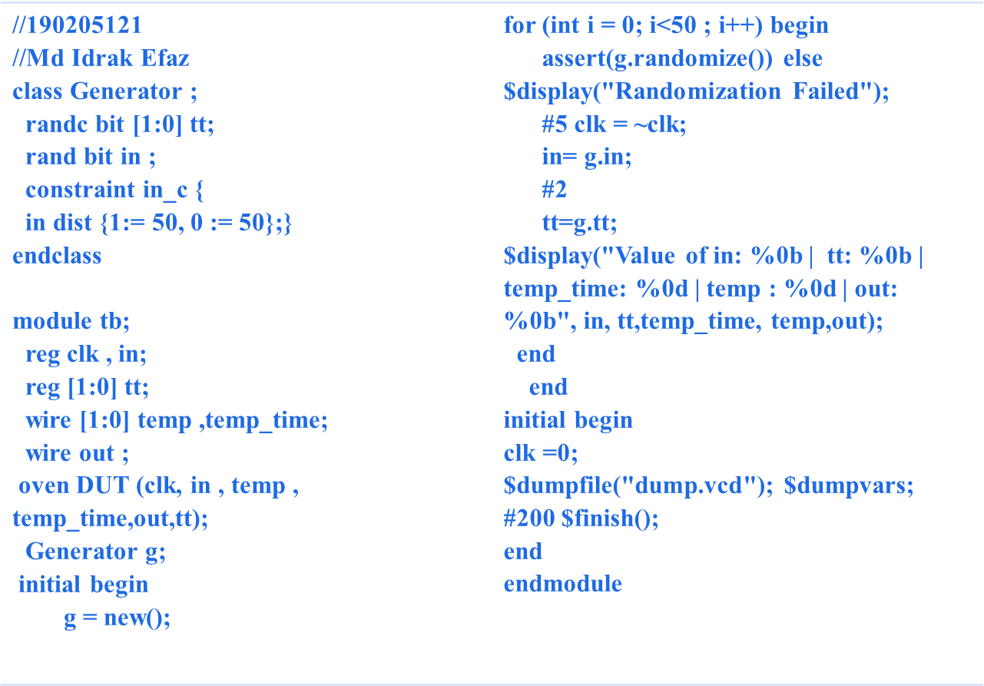
TESTBENCH

Slide 6

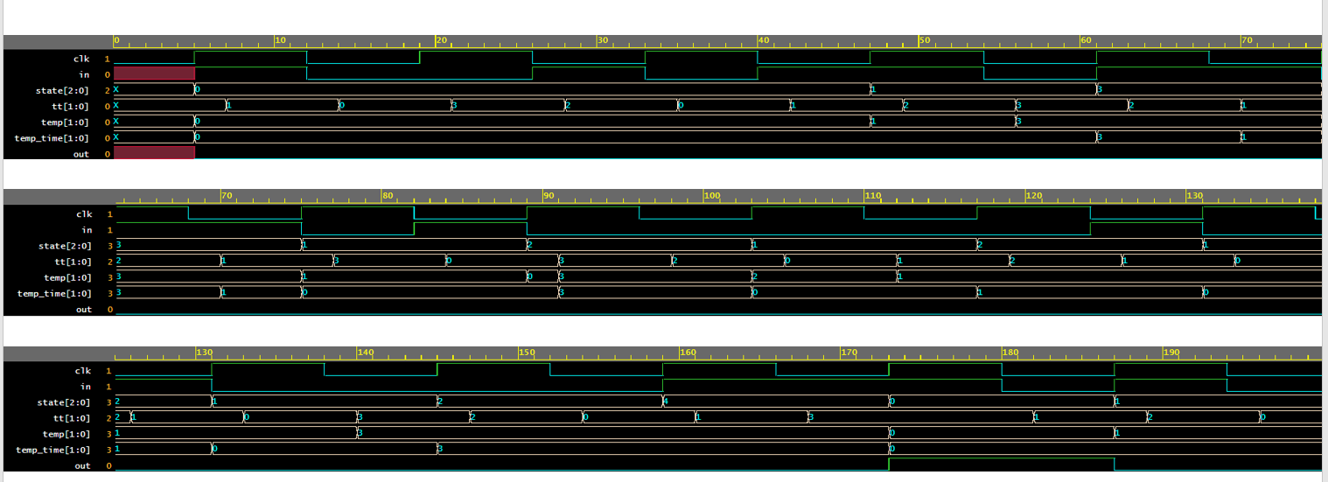

TESTBENCH

Slide 7
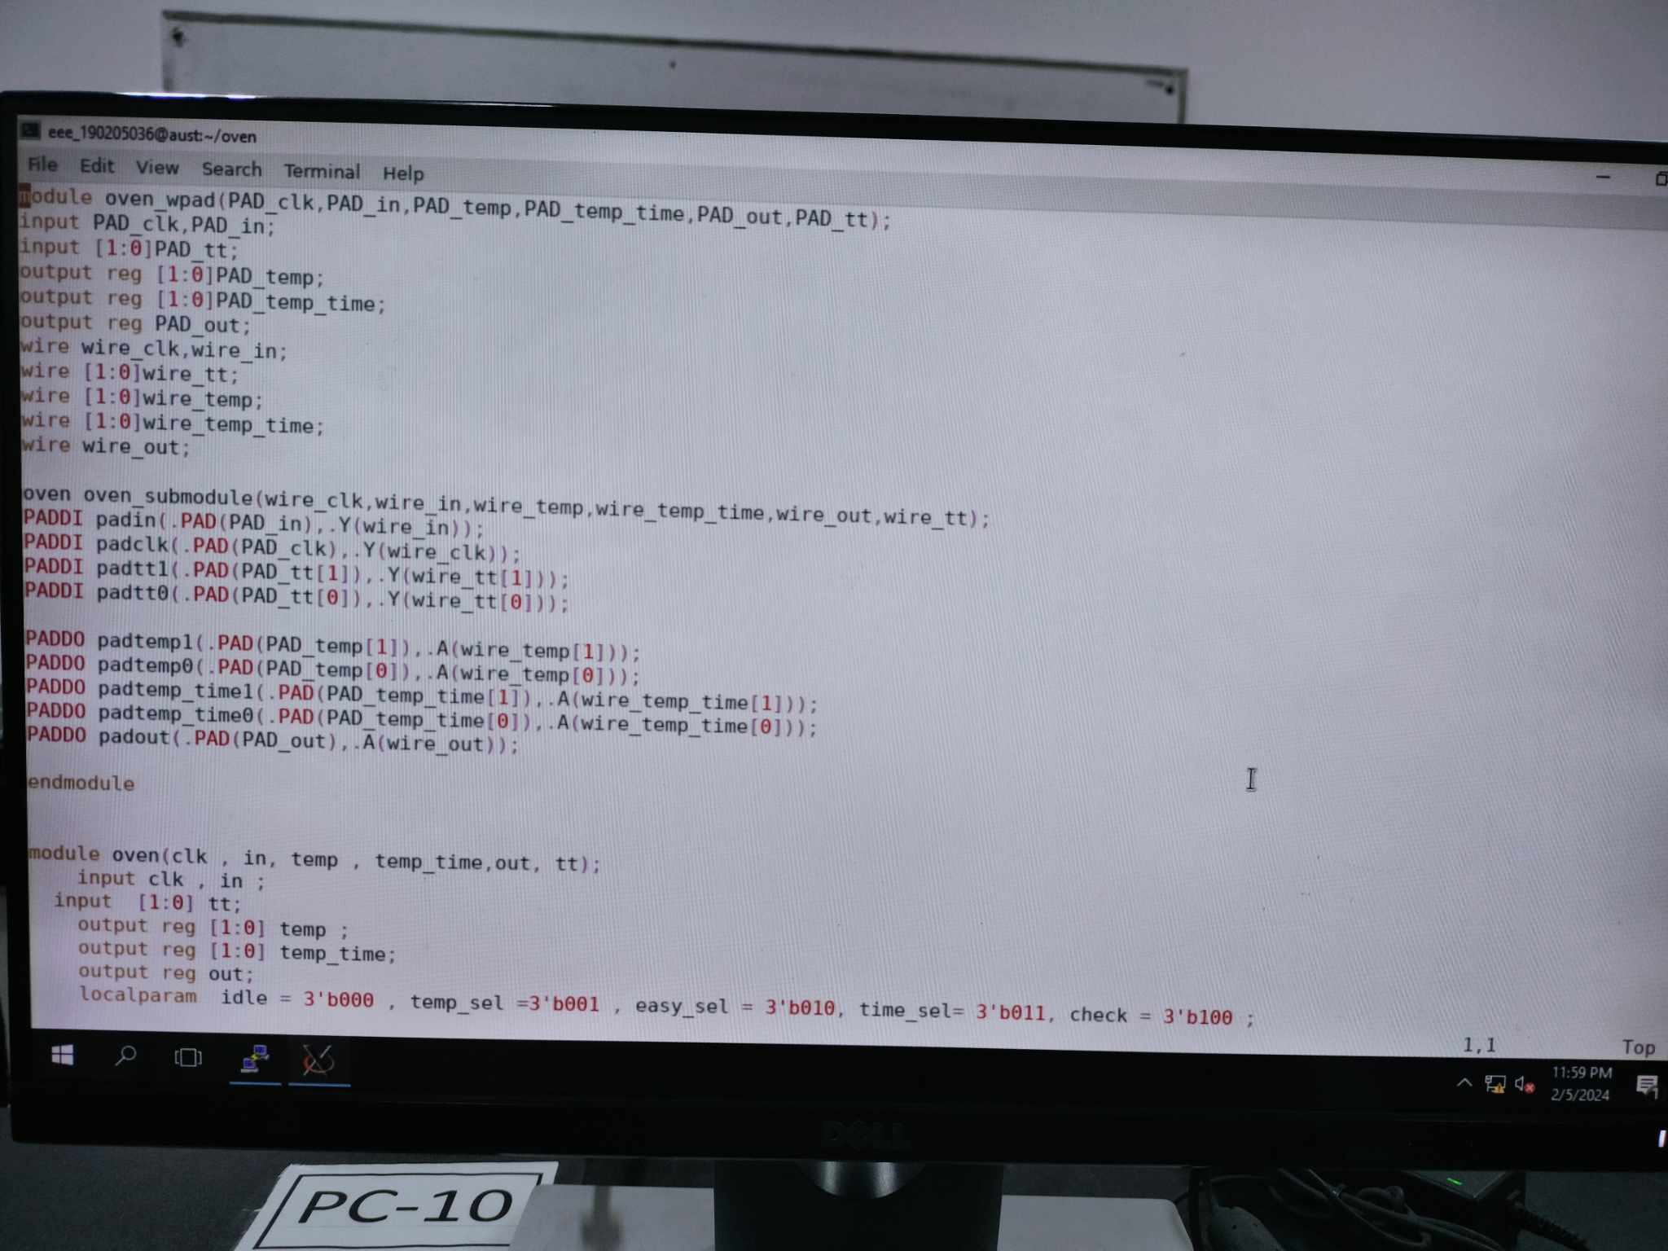
SOC DESIGN
PAD File

Slide 8
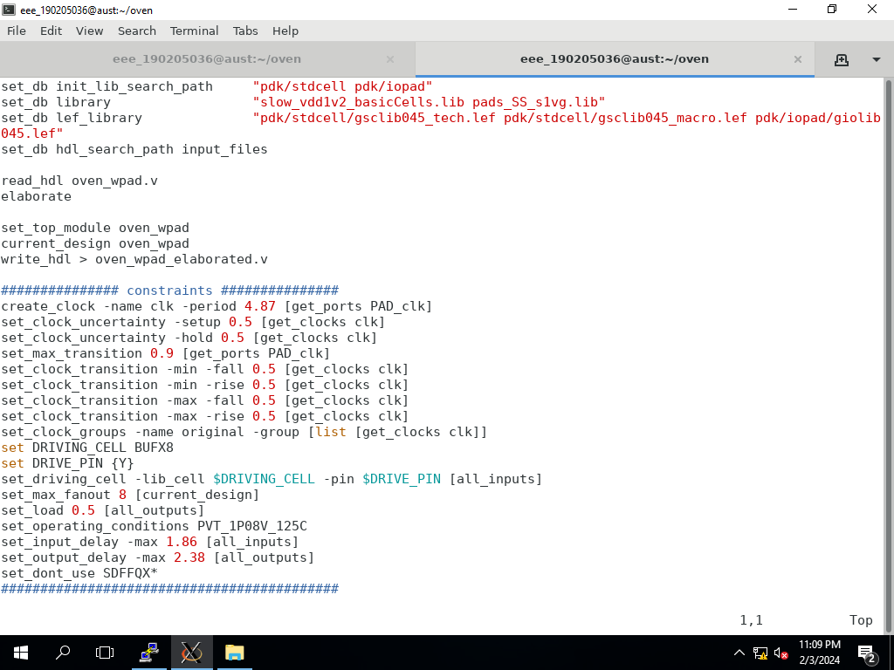
SOC DESIGN
Synthesis

Slide 9
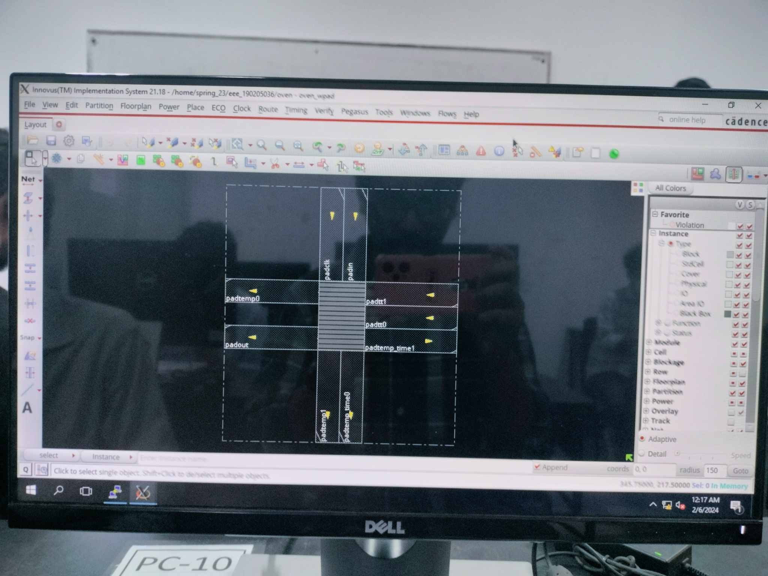
SOC DESIGN
Design Import

Slide 10
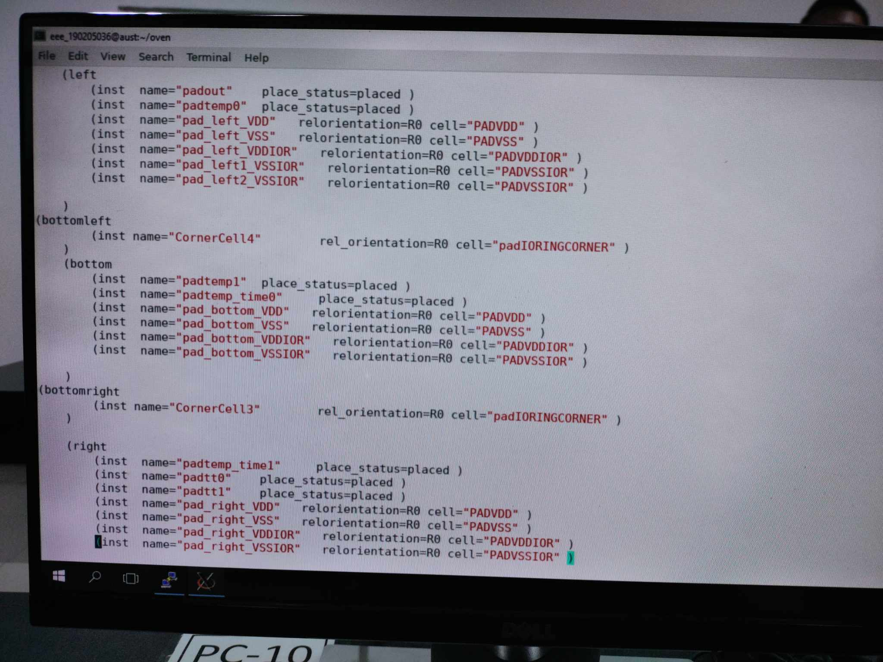
SOC DESIGN
IO File

Slide 11


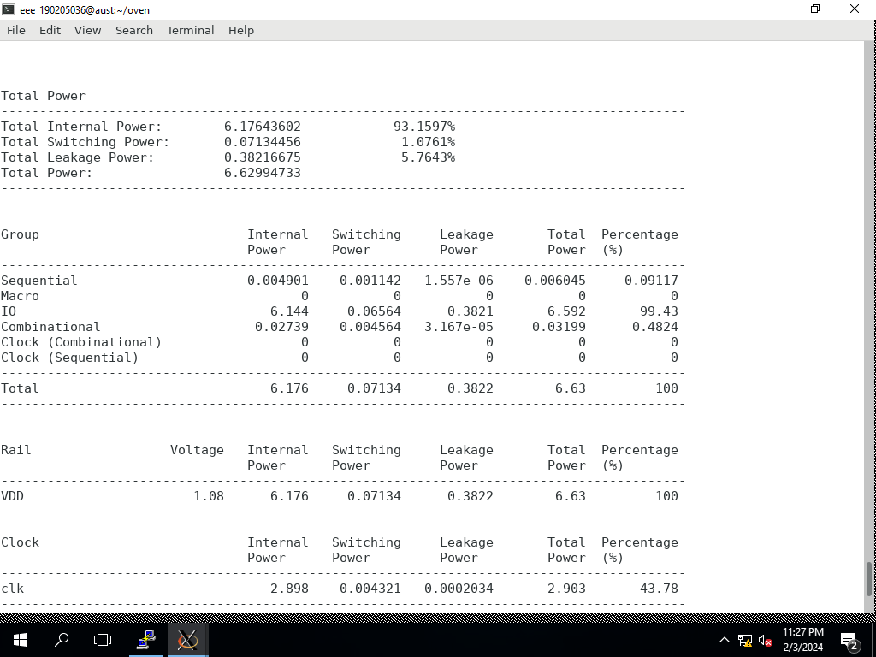

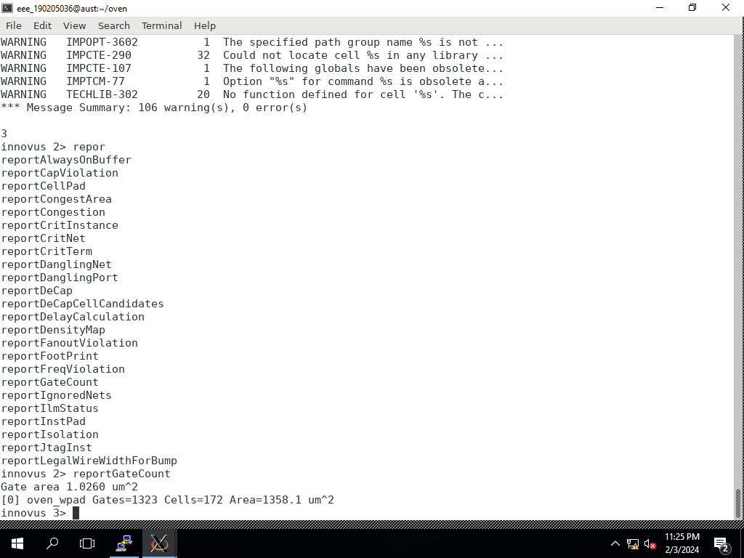
SOC DESIGN
Gate and Power Calculation

Slide 12
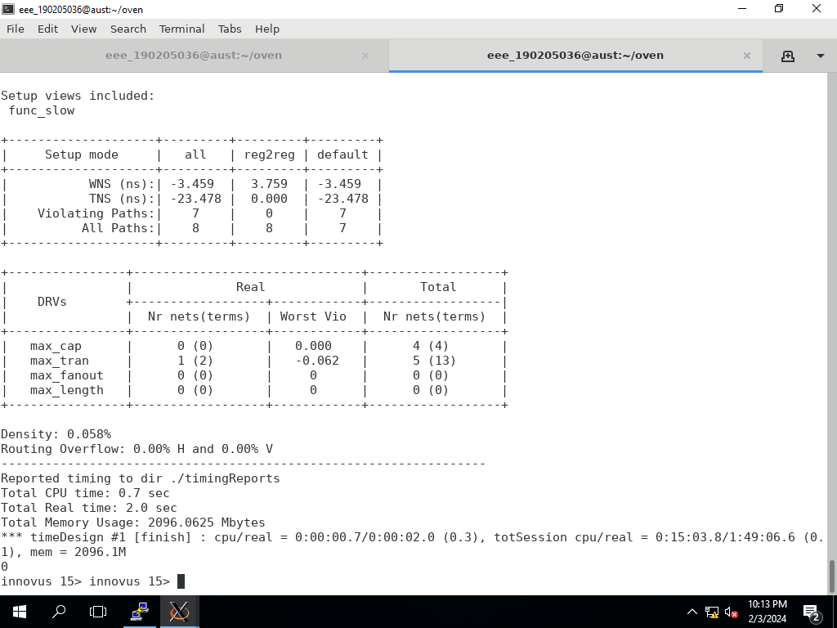
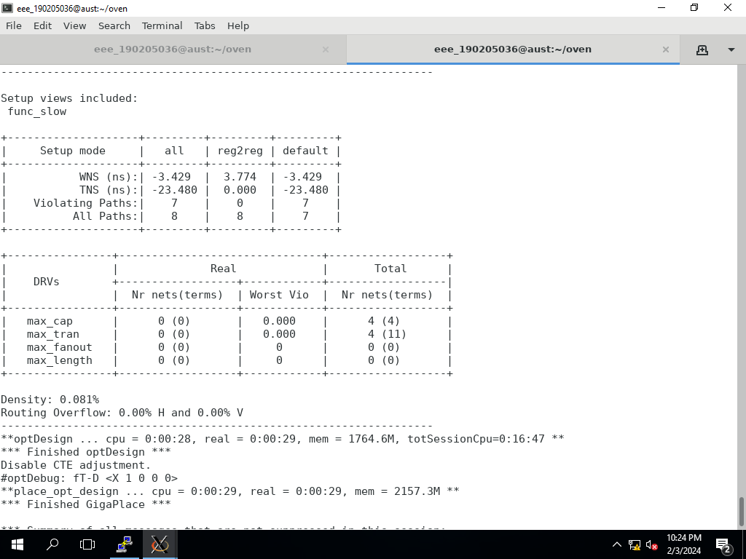
SOC DESIGN
STA Report(CTS)

Slide 13
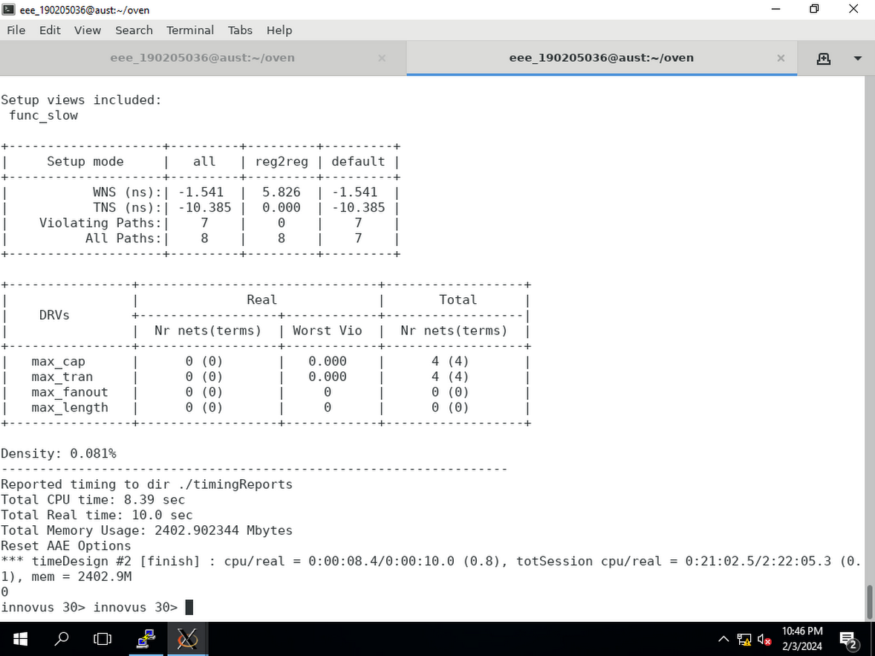
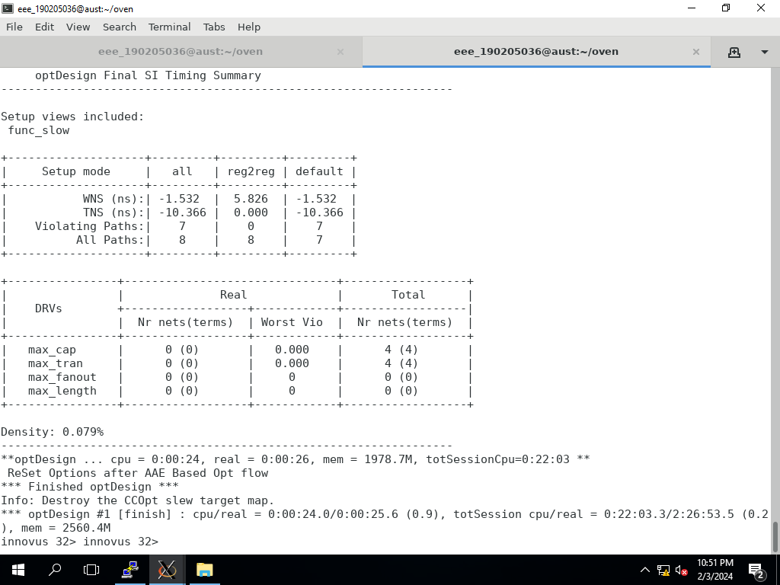
STA Report(Route)
SOC DESIGN

Slide 14

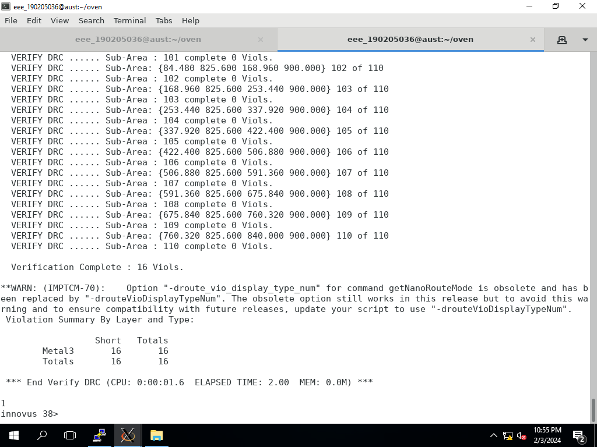
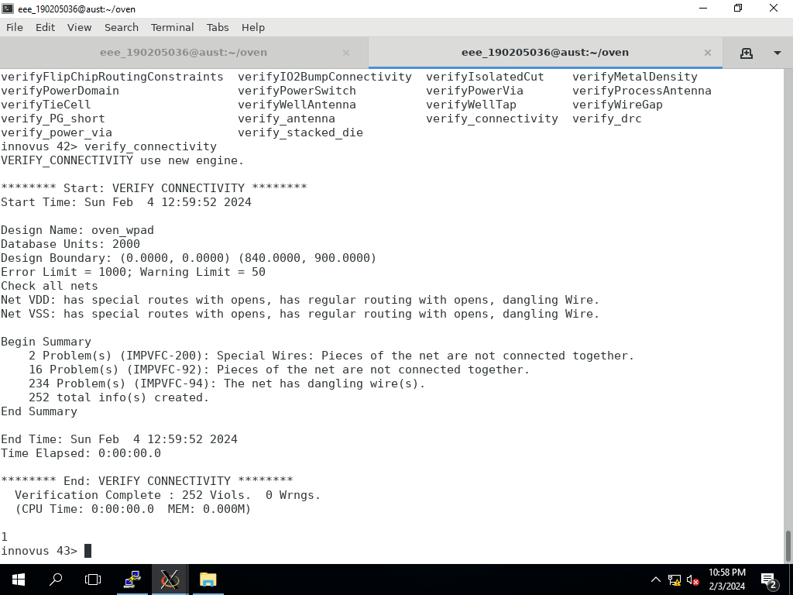

SOC DESIGN
Physical Verification

Slide 15
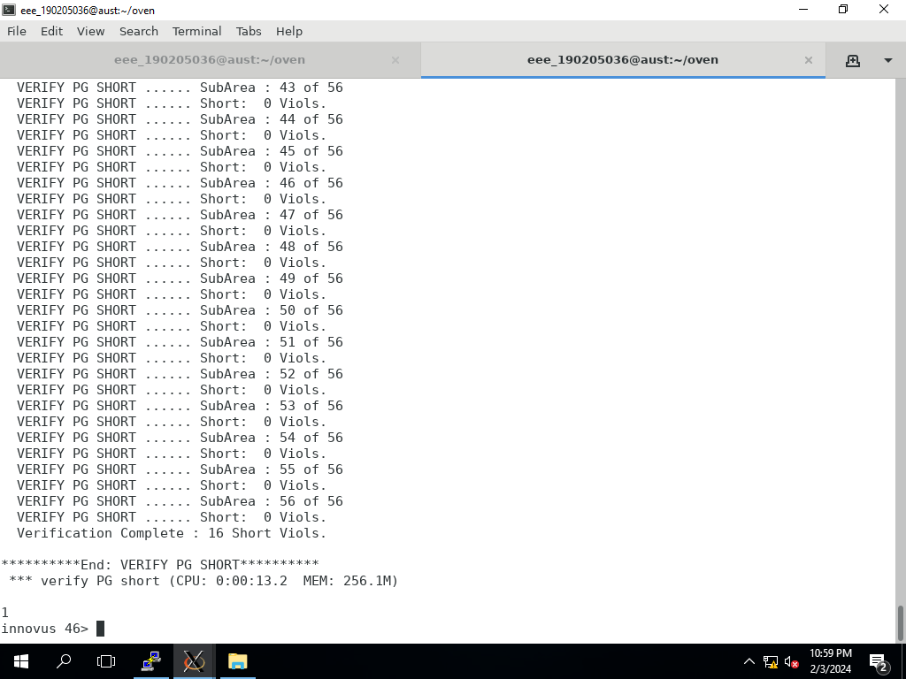
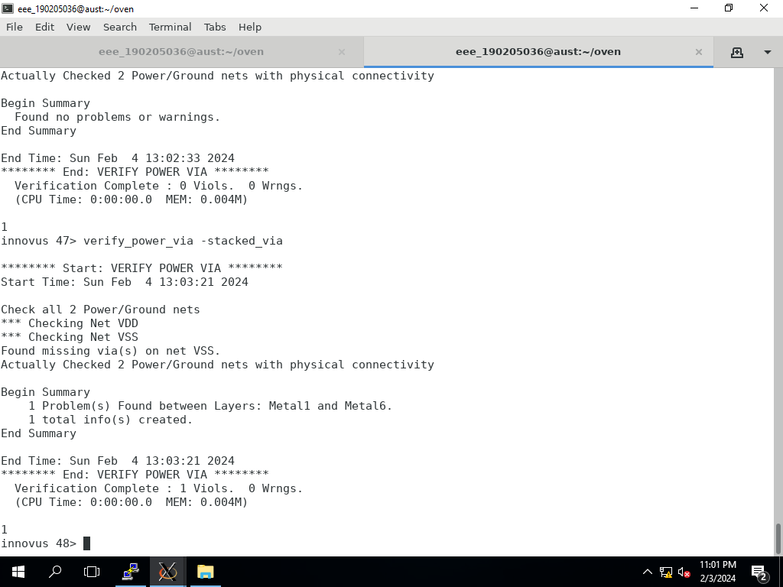
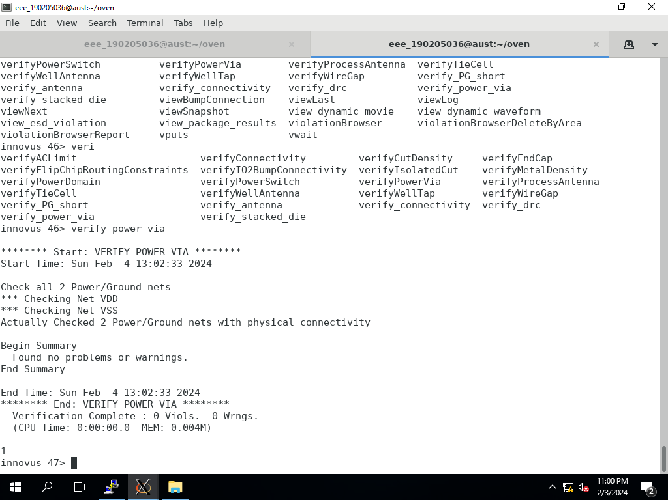
SOC DESIGN
Physical Verification

Slide 16


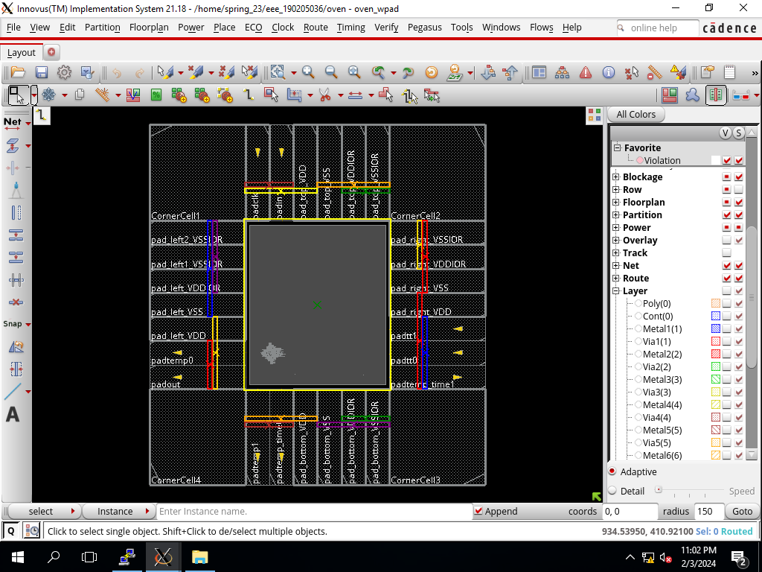

SOC DESIGN
Cell Layout

Slide 17
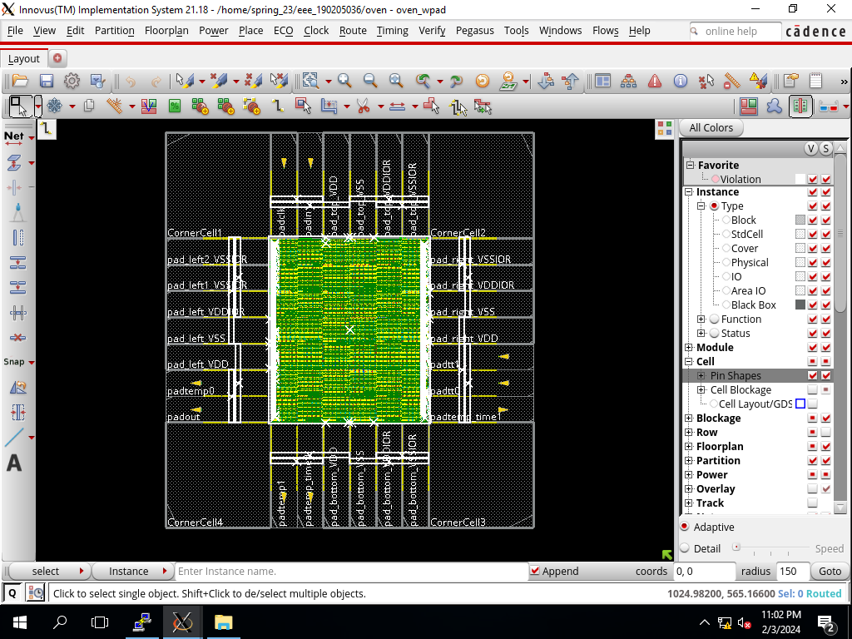
SOC DESIGN
Final Design

Slide 18
FINDINGS
Gate Count -1783
Area - 1358.1 um^2
DRC Violation - 16
Connectivity Violation - 252
PG Short Violation - 16
Stacked Power Via Violation - 1

Slide 19









CONTRIBUTION
190205058 - Project Idea, Report Writing
190205121 - RTL, Testbench
190205036 - SOC Design(Floorplan)
190205063 - SOC Design(Final Design)
190205065 - SOC Design, Presentation

Slide 20
THANK YOU FOR LISTENING!

